Slide 1

RNS INSTITUTE OF TECHNOLOGY
BENGALURU – 98
DEPARTMENT OF INFORMATION SCIENCE & ENGINEERING
Presentation on Internship
PLANT APP
Jyotsna Singh 1RN18IS057
ENMAZ Engineering Services Pvt. Ltd.
Internal Guide
Mrs. Chandan Rani
Asst. Prof, Dept of ISE, RNSIT
External Guide
Mr. Akshay DR
Co Founder & CEO,
Enmaz Engineering Services pvt.
Ltd, Bangalore

Slide 2
AGENDA
Abstract
About the Company
Introduction
Literature Survey
Requirements
System Design
Schema Design
Implementation
Testing
Conclusion and Future Enhancements
References
Q & A
VII Semester, Department of ISE, RNSIT
2021 - 2022

Slide 3
ABSTRACT
The Plant App is a mobile application developed using flutter.
On entering login details, the App starts.
The browsing page opens which has three categories products, inspirations, and shops.
Pictures and descriptions of each category are provided on a separate page.
VII Semester, Department of ISE, RNSIT
2021 - 2022

Slide 4
About the Company
Enmaz has a simple yet robust solution that helps any Industry / Factory digitalize their work floor fastly. The products offered help in remote monitoring and analyzing machine parameter processes.
Reliable Hardware: Time tested, high quality, designed, developed, and manufactured in India. 18 months of replacement warranty.
Innovative Software: Easy to use, highly scalable, and cloud-based IoT platform. Dynamic dashboard, Reports, Remote control, and Email & SMS alerts.
VII Semester, Department of ISE, RNSIT
2021 - 2022

Slide 5
INTRODUCTION
Plant App is a mobile application in which people can explore different kinds of plants, seeds, flowers, sprayers, pots and fertilizers etc.
It’s a fun way to learn. People will get to know about different new varieties of plants
As the user interface is attractive so people will have interest while exploring.
VII Semester, Department of ISE, RNSIT
2021 - 2022

Slide 6
LITERATURE SURVEY
A learning environment is an environment in which students become totally involved in the learning process.
Since mobile devices support anytime, anywhere learning, m- learning can foster the growth of learning.
Flutter as a cross-compiler compared to two native applications made of kotlin and Android studio and swift and XCode, in terms of CPU performance.
With the use of smart mobile devices with wireless networks enables mobility and mobile learning, allowing teaching and learning.
VII Semester, Department of ISE, RNSIT
2021 - 2022

Slide 7
Requirements
Hardware Requirements
CPU: Pentium processor and above
RAM: 4 GB
HDD: 40 GB
Software Requirements
Operating System: Windows 8 and above
Editor: Visual Studio Code
IDE: VS Code
Front-end Language: Dart
Minimum Android Version: Froyo (API Level 8)
VII Semester, Department of ISE, RNSIT
2021 - 2022

Slide 8
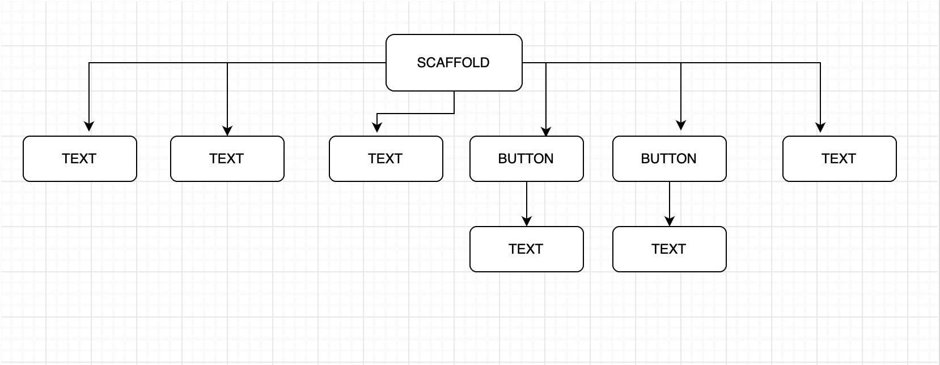
System Design
Greetings Page Widget Tree
VII Semester, Department of ISE, RNSIT
2021 - 2022

Slide 9
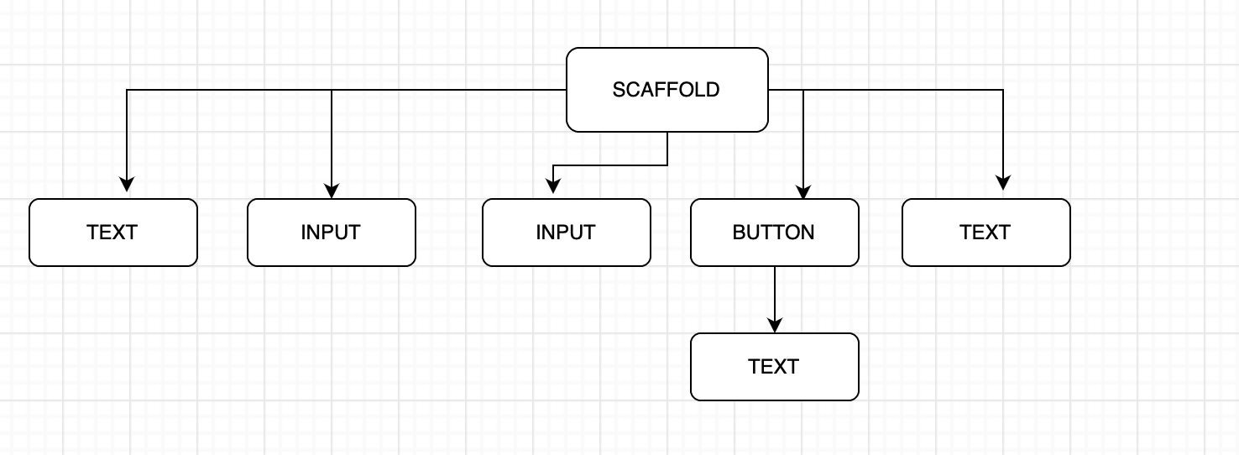
System Design
Login Page Widget Tree
VII Semester, Department of ISE, RNSIT
2021 - 2022

Slide 10
Schema Design
GREETINGS PAGE
LOGIN PAGE
BROWSING PAGE
GALLERY PAGE
SETTINGS PAGE
VIII Semester, Department of ISE, RNSIT
2021 - 2022

Slide 11
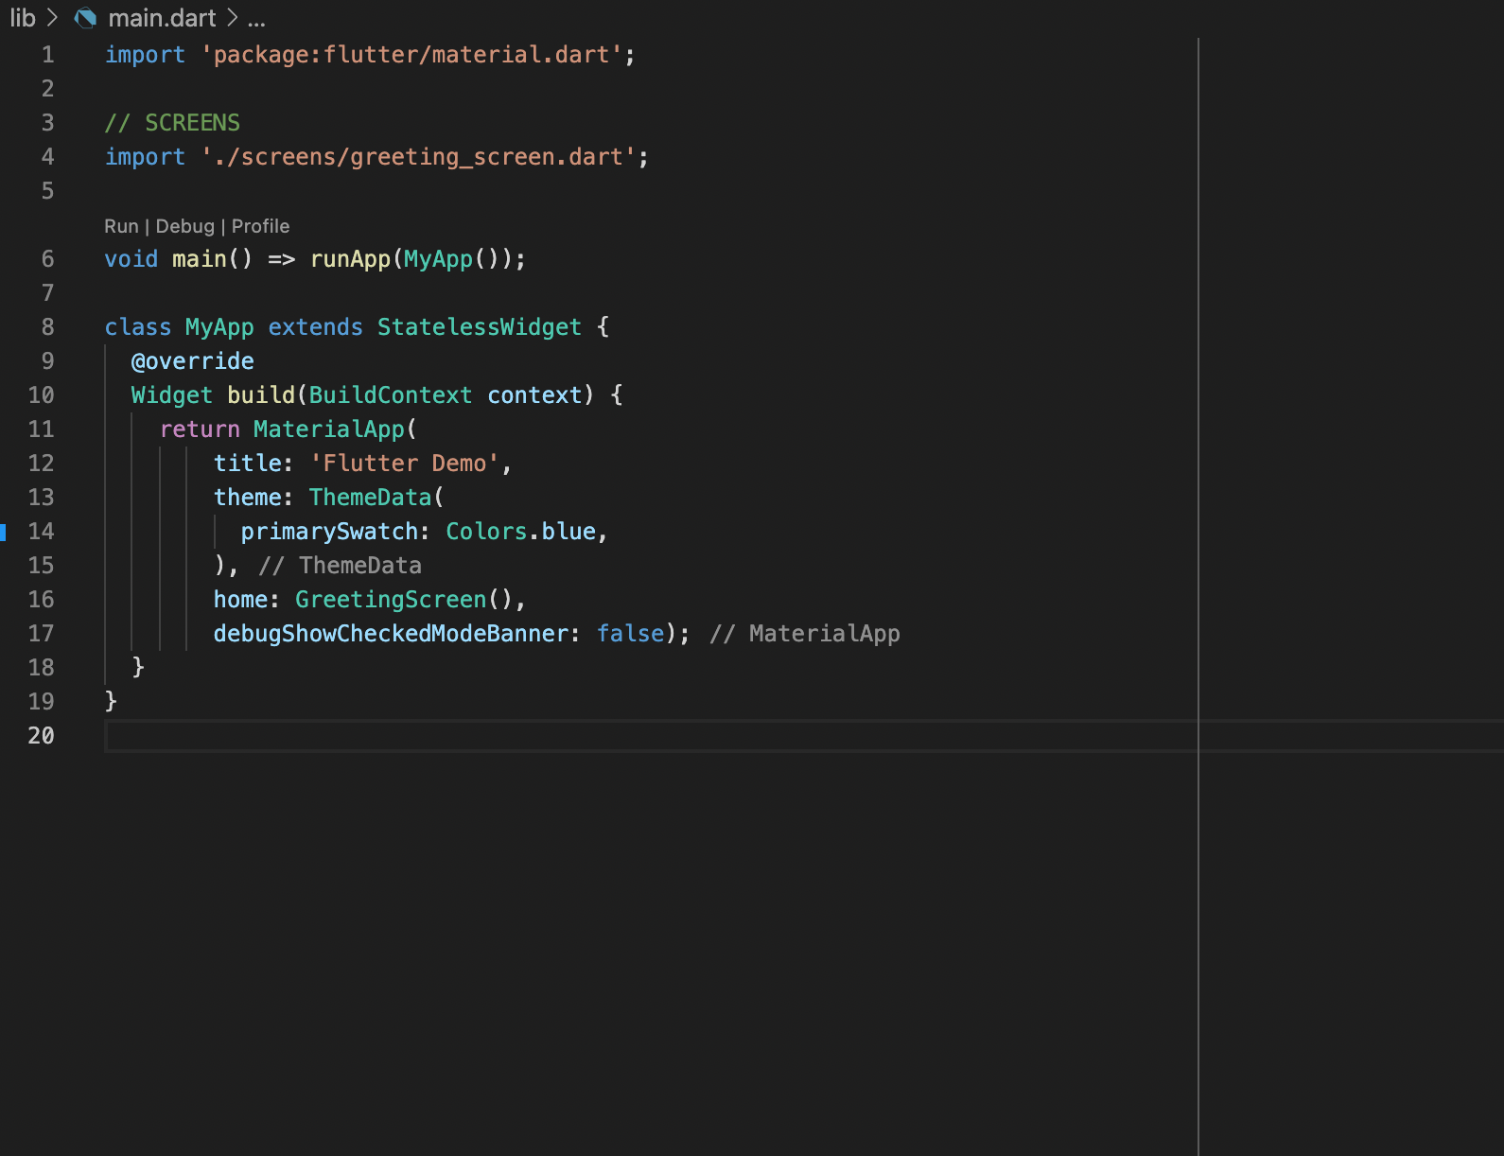
Implementation / Coding
Main.dart
VII Semester, Department of ISE, RNSIT
2021 - 2022

Slide 12
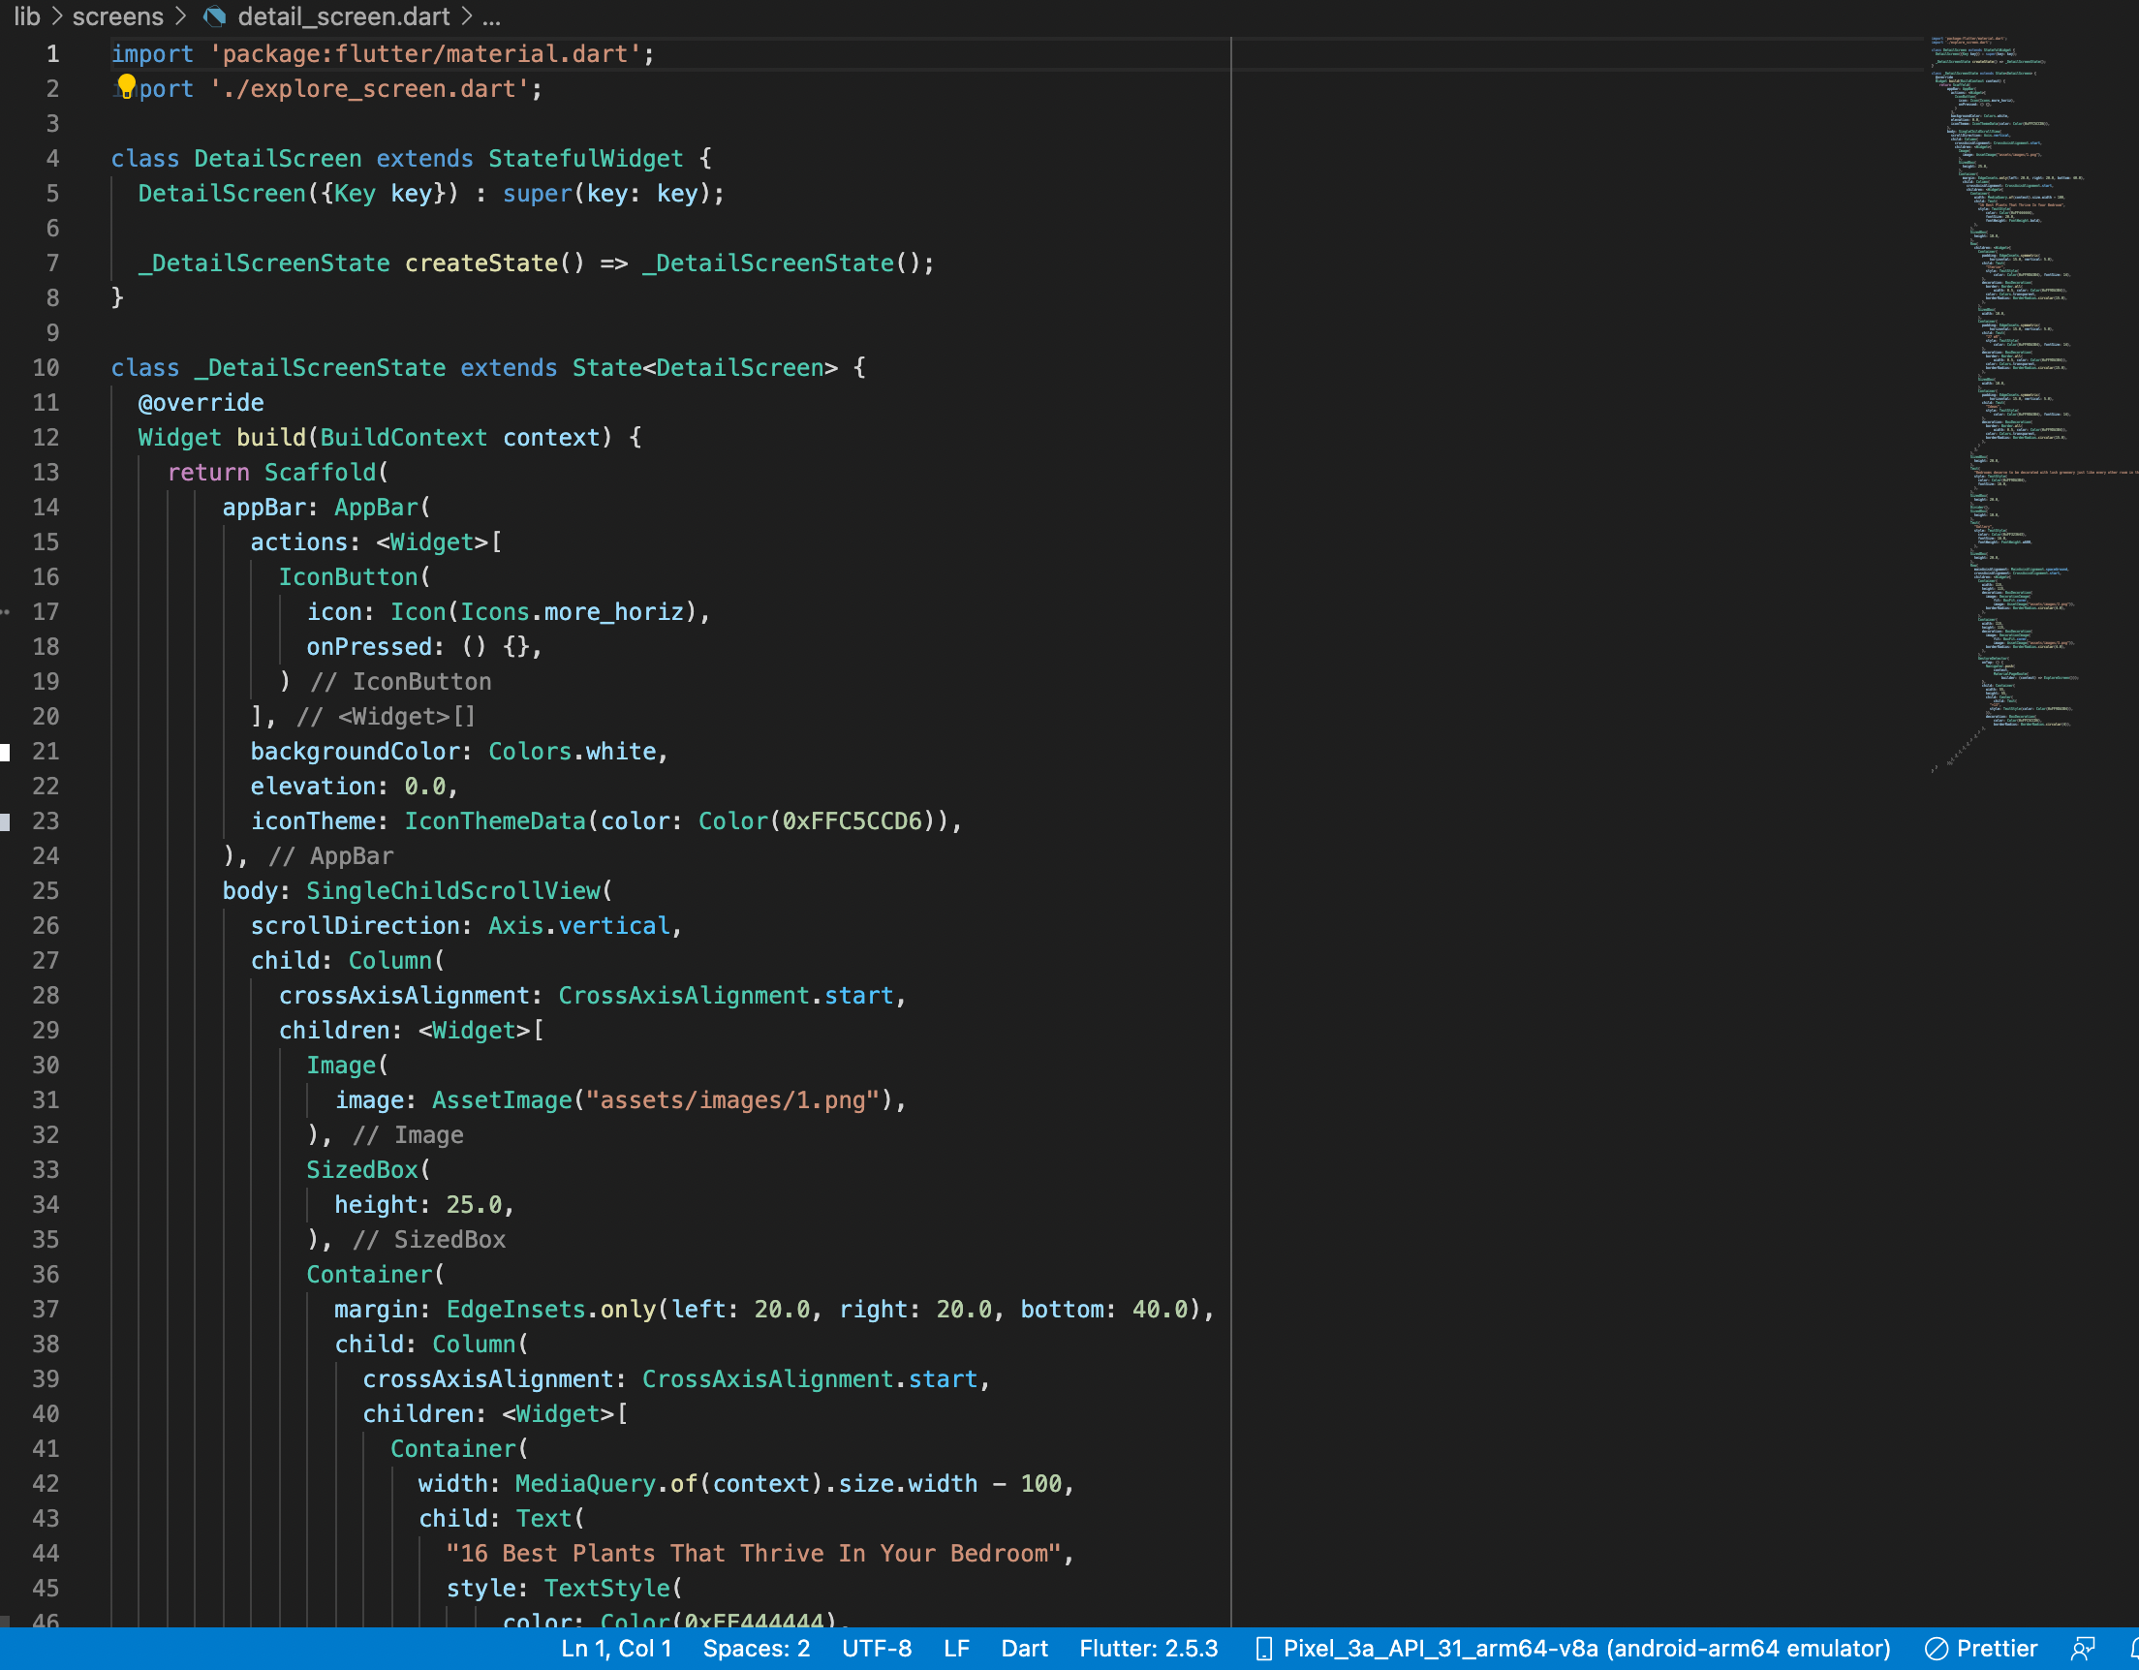
Implementation / Coding
detail_screen.dart
VII Semester, Department of ISE, RNSIT
2021 - 2022

Slide 13
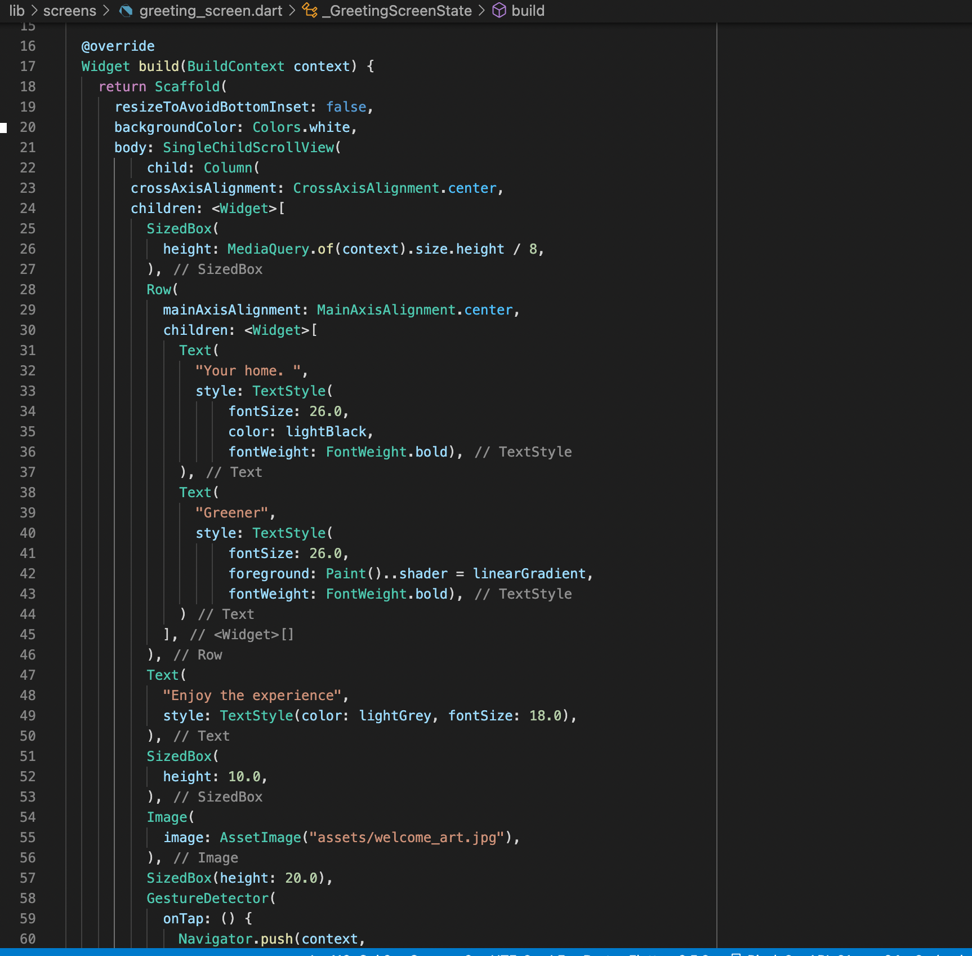
Implementation / Coding
Greeting_screen.dart
VII Semester, Department of ISE, RNSIT
2021 - 2022

Slide 14
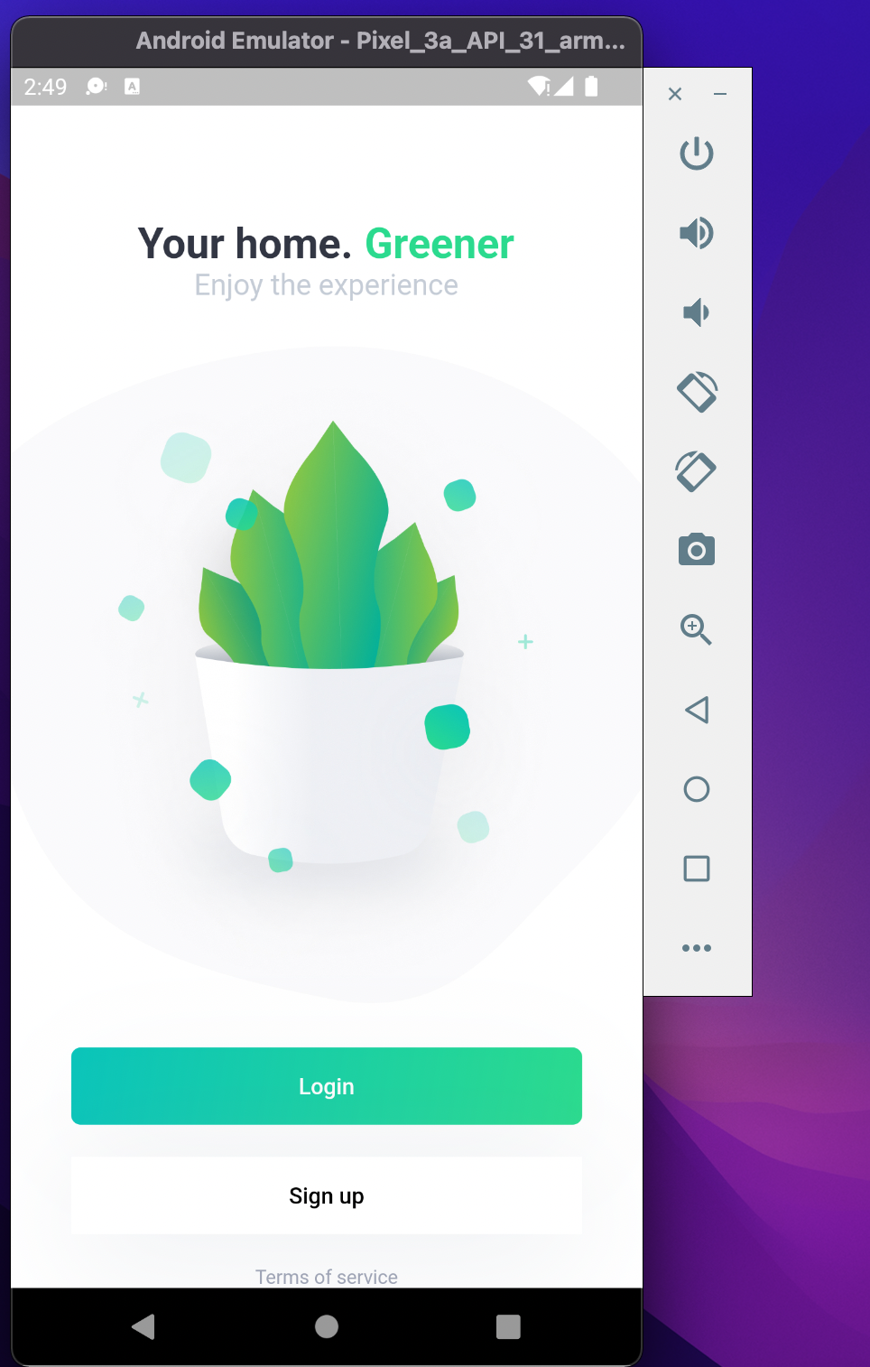
Result
Home Page
VII Semester, Department of ISE, RNSIT
2021 - 2022

Slide 15
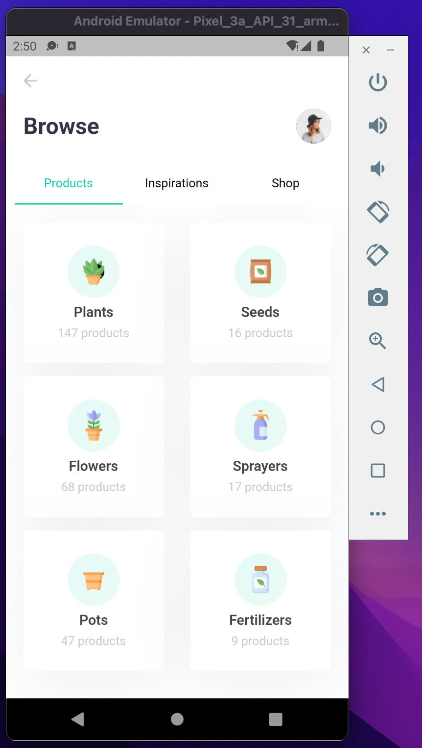
Result
Browse Page
VII Semester, Department of ISE, RNSIT
2021 - 2022

Slide 16
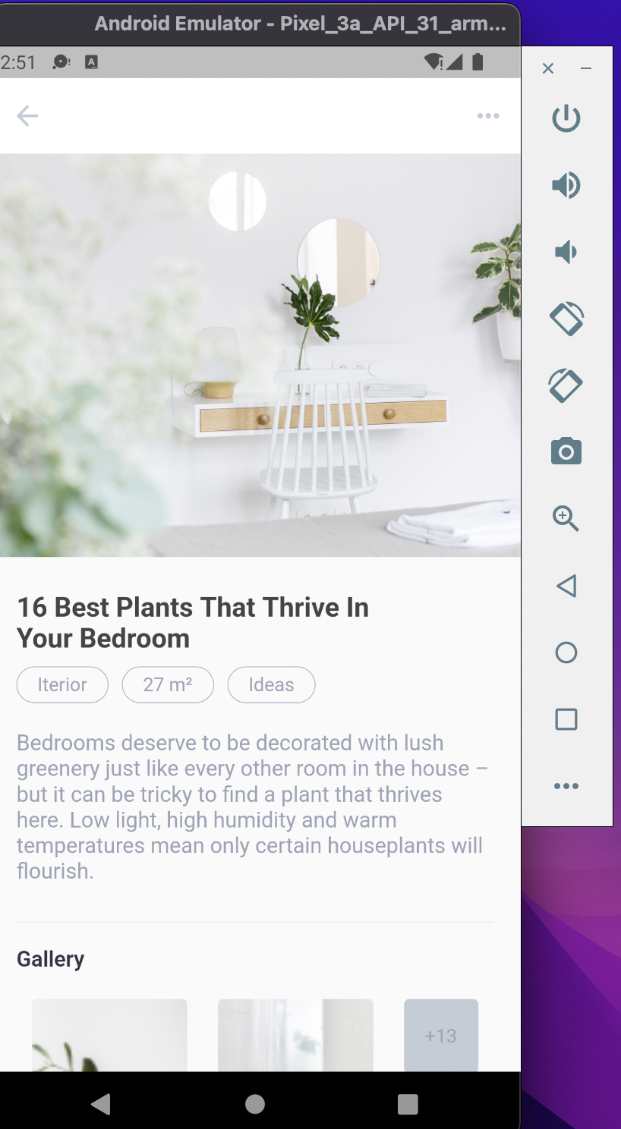
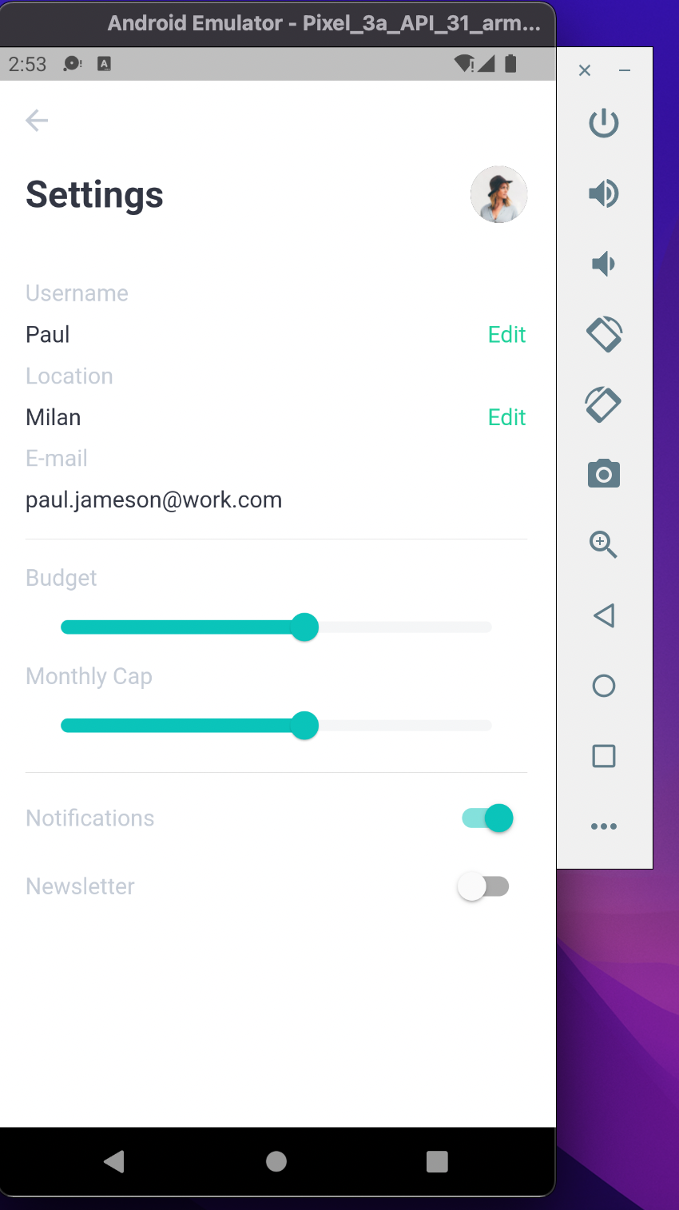
Display Details
Settings Page
VII Semester, Department of ISE, RNSIT
2021 - 2022

Slide 17
Testing
Testing is a process of executing a program with the interest of finding an error. Levels Of Testing:
Unit Testing
Integration Testing
Validation Testing
Output Testing
User Acceptance Testing
VII Semester, Department of ISE, RNSIT
2021 - 2022

Slide 18
CONCLUSIONS
This plant application provides the facility to gain knowledge about any varieties of plants at your fingertips.
It saves time since the user does need to go to the nursery.
Descriptions and pictures about plants, seeds, fertilizers, etc are given properly.
VII Semester, Department of ISE, RNSIT
2021 - 2022

Slide 19
Future Enhancements
We can try and deploy it on the internet so that people can access it online also.
We can try to add a backend to the app and host it on the server.
We can also let the different users access the app simultaneously with their unique id.
VII Semester, Department of ISE, RNSIT
2021 - 2022

Slide 20
REFERENCES
SQL Tutorial-java point
dart docs
flutter docs
VII Semester, Department of ISE, RNSIT
2021 - 2022

Slide 21
VII Semester, Department of ISE, RNSIT
2021 - 2022

Slide 22

VII Semester, Department of ISE, RNSIT
2021 - 2022

